Slide 1
Proposed Budget Presentation
Fiscal Year 2024-2025

Slide 2
Budget Process
Community Survey of Priorities – Completed in December
City Council Sets Priorities for Year – Completed in December
Department Head Submittal of Requested Budget to City Manager – Completed in March
City Manager Submittal to City Council – Completed in April
City Council Workshop on Proposed Budget – Scheduled for April 17
Individual Meetings with Council Members to Answer Questions – As Needed
Additional Budget Workshops – As Needed
Public Hearing Prior to Adoption – To Be Scheduled
Council Adoption of Budget – Required No Later Than June 30

Slide 3
Purpose and Development
The overriding purpose of the budget can be defined in three key points:
Allocation of public resources over time and among public operations.
Accountability to the public for the expenditure of public funds.
Maintenance of financial stability of the City of Saugatuck.

Slide 4
Guiding Principles
Fiscal Responsibility:
“City Council and staff will serve as stewards of the City’s fiscal resources in safeguarding assets, planning long-term financial stability and maintaining adequate contingency reserves. Fiscal activities will be justifiable, efficient, effective, transparent and accountable.”
Maintain and Improve Public Infrastructure and Facilities:
“The City of Saugatuck understands the very basic foundation of any successful municipality is a well maintained and sustainable infrastructure that meets the functional needs of the community.”
Friendly, Honest and Transparent Government:
“The City of Saugatuck is committed to providing timely and accurate information about City services and openly sharing information about City actions, events and decisions to our residents and businesses in the most friendly, honest and transparent manner possible. Our commitment is to our customers.”
Position Saugatuck as a Recreational and Cultural Center That Attracts Visitors:
“The City of Saugatuck will capitalize on our diverse community and our respect for the City’s history, unique character and natural resources. We will develop facilities and amenities that promote Saugatuck as a small-town tourism destination.”
The City’s Employees are its Most Valued Asset:
“None of the high level of services that Saugatuck City residents, businesses and visitors enjoy would be possible without the City’s small but highly trained and dedicated workforce. The City of Saugatuck strives to treat all employees fairly in their job position classifications in order to recruit and retain the best employees who are focused on public service and are always willing to work with all stakeholders in achieving success”

Slide 5
Funds
101 - GENERAL FUND
Largest Fund
Government resources and activities not listed in other funds
202 - MAJOR STREETS
Maintenance and construction of the Major Streets System
203 - LOCAL STREETS
Maintenance and construction of the Local Streets System
301 - DEBT SERVICE
Account for payment of principal and interest on City's debt
592 - WATER/SEWER
Fees collected for water/sewer
661 - MOTOR POOL
Maintenance of the Motor Vehicle Fleet
The City of Saugatuck currently has six separate funds.

Slide 6
Organization
11 Full Time Staff
City Manager
City Treasurer
City Clerk
Director of Planning and Zoning
Department of Public Works Superintendent
Assistant DPW Supervisor
Deputy City Clerk/DPW Administrative Assistant
DPW Maintenance Workers
DPW Maintenance Worker/Oval Beach Manager
5 Seasonal DPW Maintenance Staff
25 Seasonal Oval Beach Staff
Contracted City Attorney
Contracted Sheriff’s Deputies
Contracted Engineer
Contracted Planner
Contracted Assessor

Slide 7
City at a Glance
Census Population: 865
Square Miles: 1.47
Housing Units: 916
Median Household Income: $113,309
Median Age: 58
Parks: 330 acres
Oval Beach, Saugatuck Harbor Natural Area, Mt. Bladhead , Coghlin Park, Jones Park, Cook Park, Wicks Park, Willow Park, Peterson Preserve and Village Square Park.
Roads: 11.5 miles.
Water Utilities: 298 curb stop valves, 138 fire hydrants, 302 system valves, and 14.6 miles of main.
Sanitary Sewer Utilities: 17 lift stations, 259 manholes, and 4.8 miles of gravity/force main.
Storm Sewer Utilities: 84 manholes, 68 catch basins, 51 outfalls and 6.7 miles of gravity main.

Slide 8
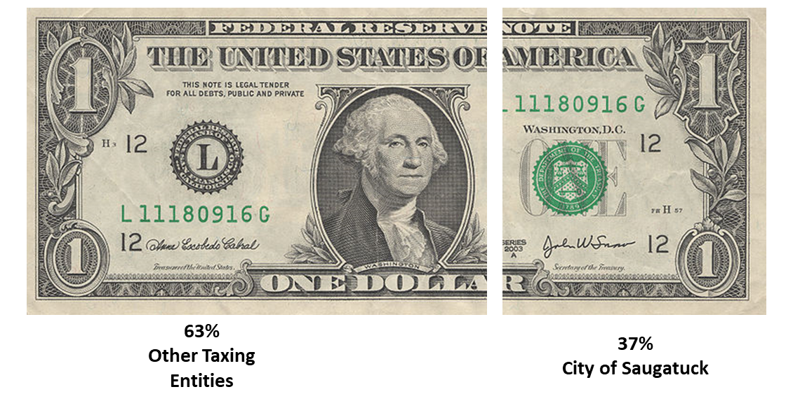
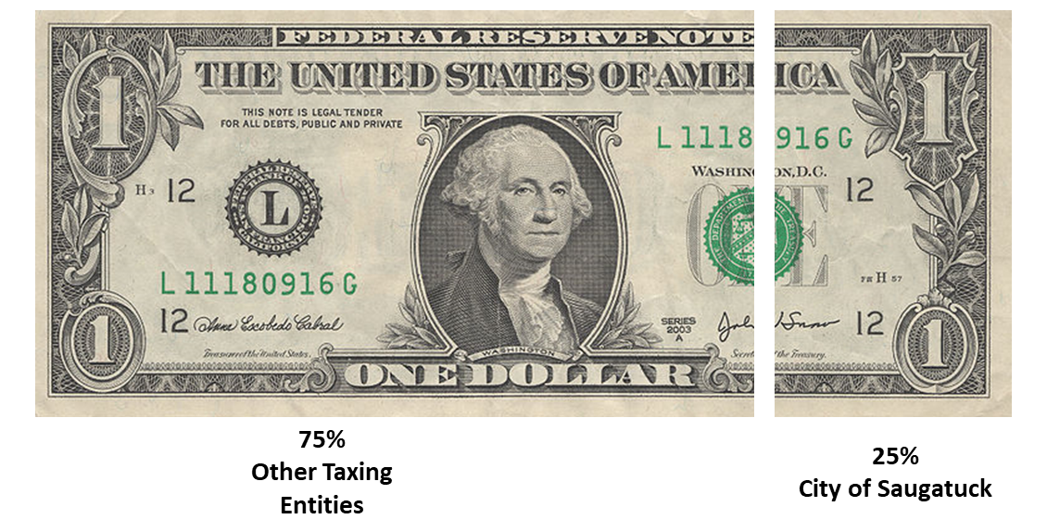
Where does each tax dollar go?
Principal Residence Exemption Properties
Non-Principal Residence Exemption Properties

Slide 9
How does our operating tax rate compare?

Slide 10
General Fund
The General Fund is the City’s general operating fund and accounts for all financial resources of the general government, except for those required to be accounted for in another fund. The general fund is made up of sixteen (16) departments. These departments include:
101 COUNCIL
173 CITY ADMINISTRATION
215 CITY CLERK
253 CITY TREASURER
257 ASSESSING
265 CITY HALL
301 POLICE
441 PUBLIC WORKS
721 PLANNING/ZONING
723 HISTORIC DISTRICT COMMISSION
730 HARBOR
751 PARKS & RECREATION
756 OVAL BEACH
758 OVAL CONCESSION
760 SPEAR BOAT LAUNCH
965 TRANSFERS

Slide 11
General Fund Balance
City savings/cash reserves.
Total: $5,828,000
Restricted
Parks - $1,000,000
Policy decision. Request may be made to apply Playground expenses against this.
Rose Garden - $113,000
Unrestricted: $ 4,715,000
Very healthy.
Important to strike the right balance of keeping adequate reserves for a “rainy day” and investing in much needed maintenance and improvement of City infrastructure.
Current Policy – Keep at least $1,000,000 total in reserves.

Slide 12
General Fund Revenue Highlights
Estimated Operating Millage Rate Reduction to: 10.588 mills
Decrease of .215 mills due to Headlee Rollback
Real Property Tax Revenue Increase of $111,500
Largely due to required 5% CPI increase.
Permit Revenue Up Over Prior Years - $100,000
Largely due to zoning and historic district fee schedule adjustments in 2023, street dining, and increased fees for short-term rentals.
Interest Income - $100,000
Return on cash reserves has produced higher interest income than prior years. Interest rate reductions will have an impact.
Federal and Other Grants
TAP and DNR Trust Fund for Blue Star Trail - $1.6 million
EGLE TMF for Lead Service Lines Inventory - $175,000
Fund Balance Transfer - $421,585
Use of reserves to fund capital projects.

Slide 13
Oval Beach Fees
Recommendation: Parking fees at Oval Beach in the amount of $15 for Daily Passes, $75 for Season Passes, and $37.50 for Taxpayer Season Passes (increase per policy).

Slide 14
General Fund Appropriation Highlights
Investment in Staff
Salary/Wage increases that will allow for both a cost of living adjustment and merit increases
Tablets for Boards
- $5,000
To reduce packet printing costs
Contribution to July 4 Fireworks - $4,000
Elections - $25,000
Early voting in August and November and needed voting equipment
File Scanning - $10,250
Scan all historical files in basement so they are digital and searchable

Slide 15
Legal Fees
Reduced by $125,000 from last years budget.
City Council - $250,000
City Manager - $60,000
Planning/Zoning - $65,000
Note: Portion of permit, license, and escrow fees covers these legal costs.
City remains in litigation with Dune Ridge
Majority of legal fees are budgeted for this purpose
Other uses of legal:
Reviewing agreements as required by City code.
Drafting ordinances.
Legal research related to various matters that arise.
Updated Water/Sewer Agreements
Supporting Enforcement
Attendance at meetings
Moving to Zoom for most meetings to reduce cost.

Slide 16
Planning/ Zoning
STR Enforcement and Inspections - $63,000
Granicus Third Party, Contracted Code Enforcement, Fire Department Inspection Fees
Revenue source to support through STR license fees
Project Coordinator/Executive Assistant - $70,000
An Officer Manager position was budgeted for the current fiscal year but not filled due to City Manager transition. Title, details, salary/benefits to be further reviewed with Council.
Zoning or Master Plan Updates - $25,000

Slide 17
General Fund Projects
Blue Star Trail – $1.6 Million
TAP and DNR grants covering most of cost.
Traffic Signal at Lake/Blue Star - $200,000
In conjunction with Blue Star Trail installation. Not grant funded.
Mt. Baldhead Park - $500,000
Replace bathrooms, upper deck, and retaining wall
Invasive Species - $100,000
Milfoil and others.
City Hall - $10,000
Review of internal space and options for remodel.

Slide 18
Major and Local Streets
Funding Sources
Act 51 – State Gas Tax/Registrations - $190,000
County Road Millage - $190,000
Local Road Millage - $388,000
Major Street Fund Balance - $777,000
Local Street Fund Balance - $2,000,000

Slide 19
Major Street Projects
Maple Street - $100,000
Engineering for water main and road replacement. Will also be evaluating sidewalk installation.
From the Engineer: Given the nature of the project and the number of other projects that are anticipated to be ongoing during this one, we anticipate the schedule will be somewhat fluid. In big picture terms, we anticipate:
Completing planning work in 2024 into early 2025
Formal design work in 2025
Construction in 2026
We expect a large use of streets (and possible water) fund balance ($2.4 million) to fund this project in fiscal year 2025-2026.

Slide 20
Local Street Projects
Contractual Services - $384,000
Street painting
Asphalt resurfacing (mill and fill) work in 2024:
Lucy Street near Holland Street
Francis Street, from Water Street to Butler Street
Francis Street, from Holland Street to near Elizabeth Street
Griffith Street, from Culver Street to Mason Street
Mason Street, from Grand Street to Elizabeth Street

Slide 21
Motor Pool
Cash On Hand - $727,000
Equipment
Replace Wheel Loader $500,000
Resale of old loader will help offset some of the cost.
New Pickup Truck - $50,000
Salt Spreader for Pickup - $15,000
New Zero Turn Mower - $15,000

Slide 22
Water – Asset Management Plan Revenue
City Water Infrastructure Charge - $300,000
The recently approved Water Asset Management Plan included a recommendation by Baker Tilly that the City implement a water infrastructure replacement fee.
The revenue would help cover the cost of water main and lead service line replacements. It could only be used for water infrastructure purposes.
Two options were presented:
$23 charge per month per Metered Equivalency Unit
$20 charge per month per Metered Equivalency Unit
Saugatuck Township already had this fee for some.
Douglas has already implemented a similar fee consistent with Baker Tilly’s recommendation to them.
Staff will be bringing forth a request to implement the $20 per month per MEU recommendation.

Slide 23
Other Ideas?
Park Street – $34,000
Engineering has submitted a proposal for conceptual design work on Park Street from Campbell Road through the Mt. Baldhead area.
Planning would incorporate a separate non-motorized path or sidewalk, to the extent practical, to improve safety for non-motorized users of the corridor. Consideration would also be given to removal of encroachments in the right-of-way and retaining the character of the corridor, balancing competing goals, where required.
The design team would include engineering professionals for the technical aspects of the project and landscape architecture on the project context, landscape, Mt. Baldhead and Chain Ferry area integration, etc. The Engineer advised this will be a somewhat iterative process as ideas are developed and feedback is received from the PPWC, Park Street Study Group (PSSG) and City Council.
This was not budgeted due to long term funding of the project not yet being identified and other projects ahead of it on the capital improvement plan. Council may still wish to move forward with further study.

Slide 24
Questions/Comments/Changes

